Slide 1
MATHEMATICS-I
Lectures 21 onwards
Lecture Section 1
Instructor : P. H. Keskar
Chamber 6067D

Slide 2
Topics to be covered :
Chapter 14 : (starting with section 14.4
upto section 14.8)
Chain rule, Directional derivatives, Differentials
and Linearisation, Local and absolute extrema
(with or without constraints)
Chapter 15 (except sec. 15.6) : Double integrals
(in Cartesian, Polar coords) and triple integrals
(in cartesian, Cylindrical, spherical coordinates),
Substitution in multiple integrals.
Chapter 16 : Line and surface integrals of vector
fields, Theorems of Green, Stokes, Gauss.

Slide 3
Sec 14.4
Chain Rules

Slide 4






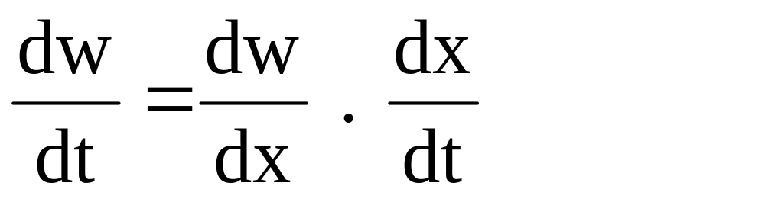
Recall from one variable calculus :
for differentiable functions

Slide 5
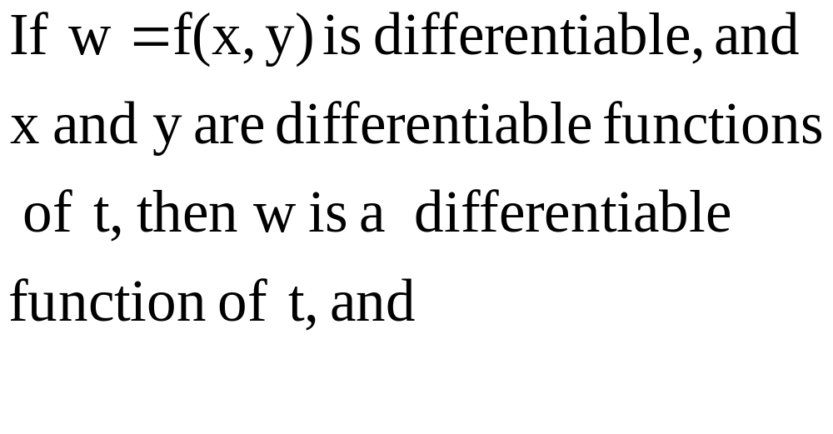
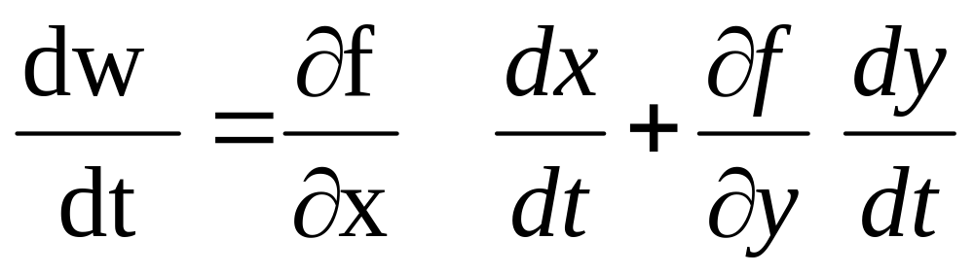

Slide 6
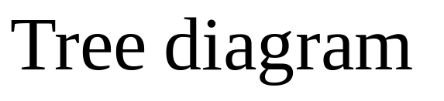
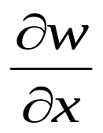
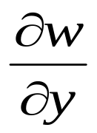
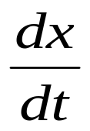
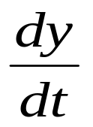
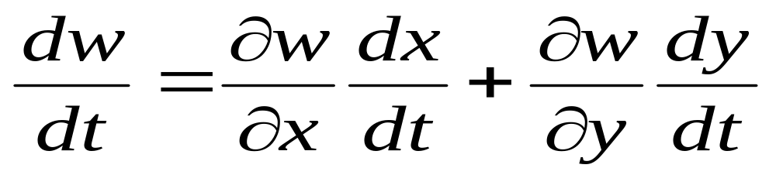
W Dependent variable
W=f(x,y)
x,y Intermediate variables
x
y
t Independent variable
t

Slide 7
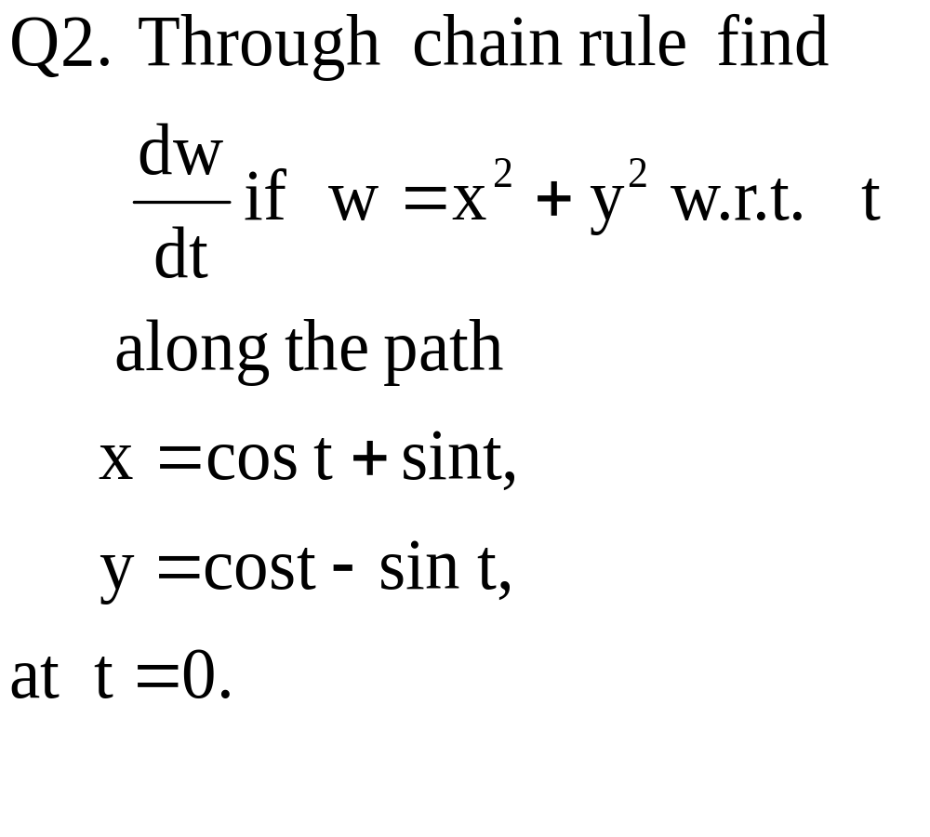

Slide 8
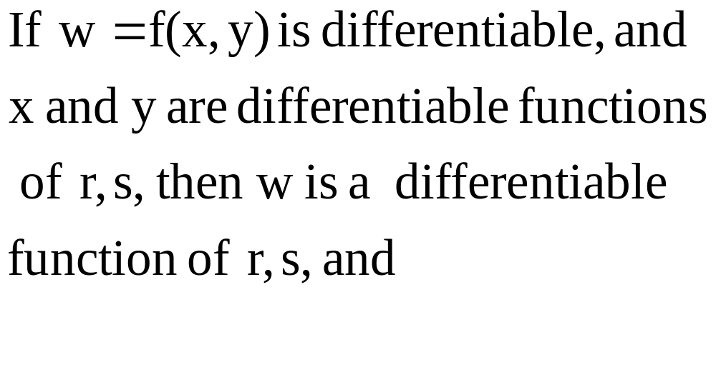
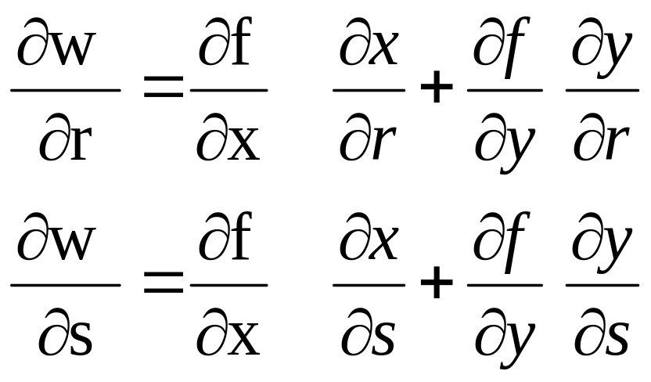

Slide 10
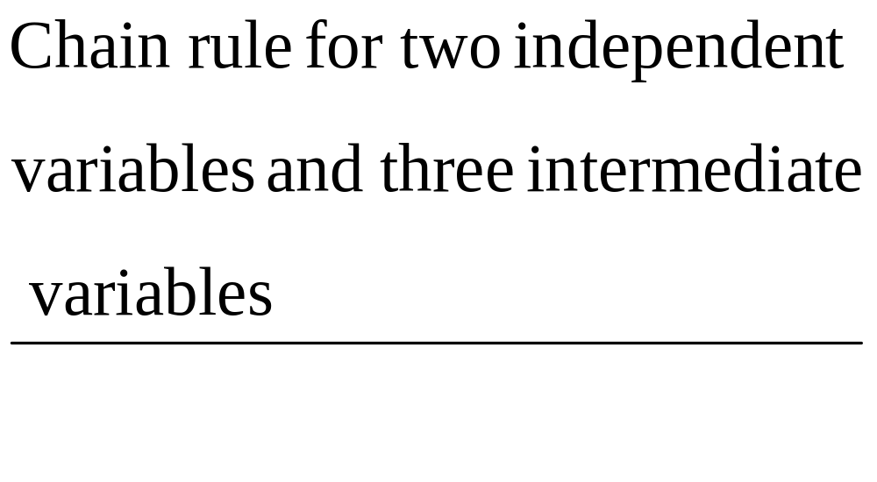

Slide 11
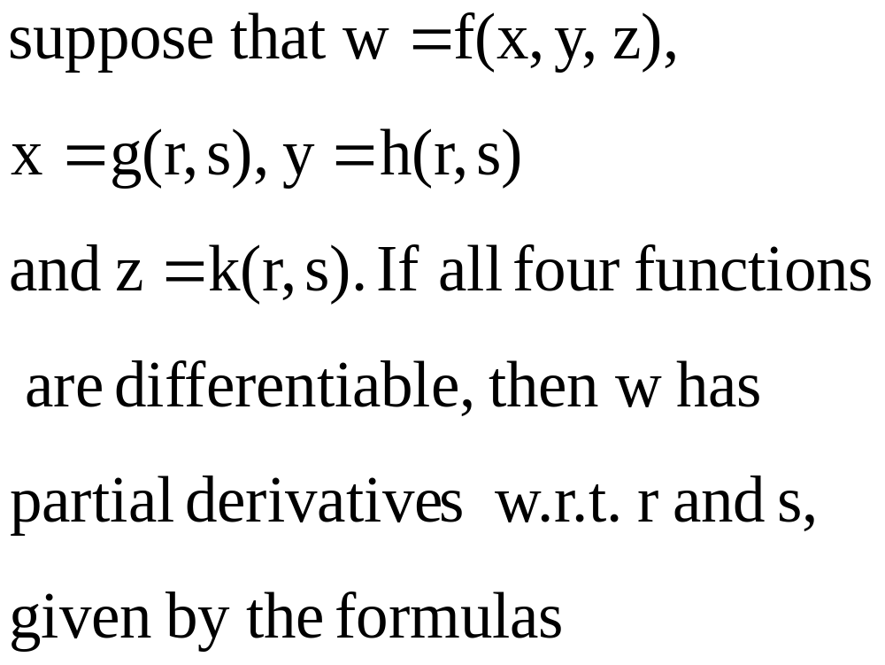

Slide 12










Tree diagrams
w
w
x
y
z
x
y
z
r
s

Slide 13
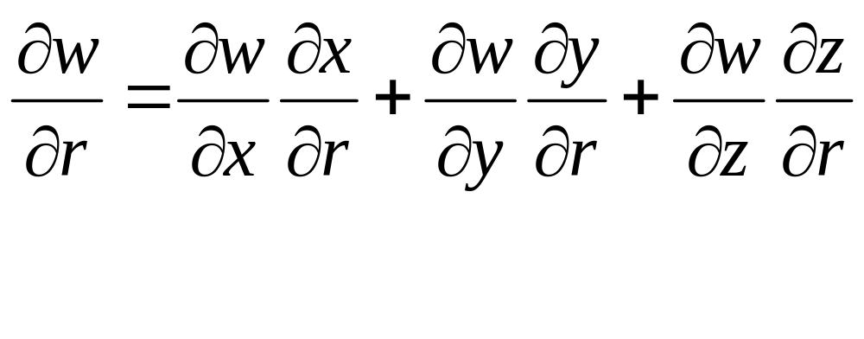
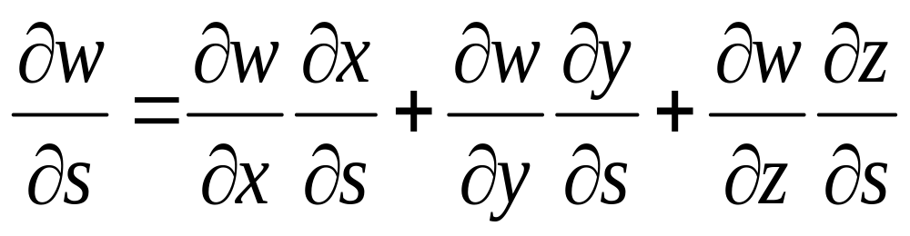

Slide 14
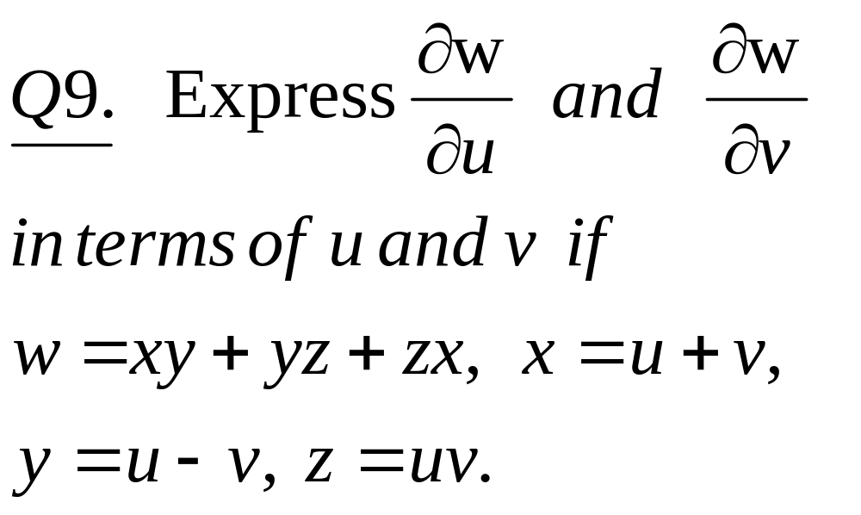

Slide 15
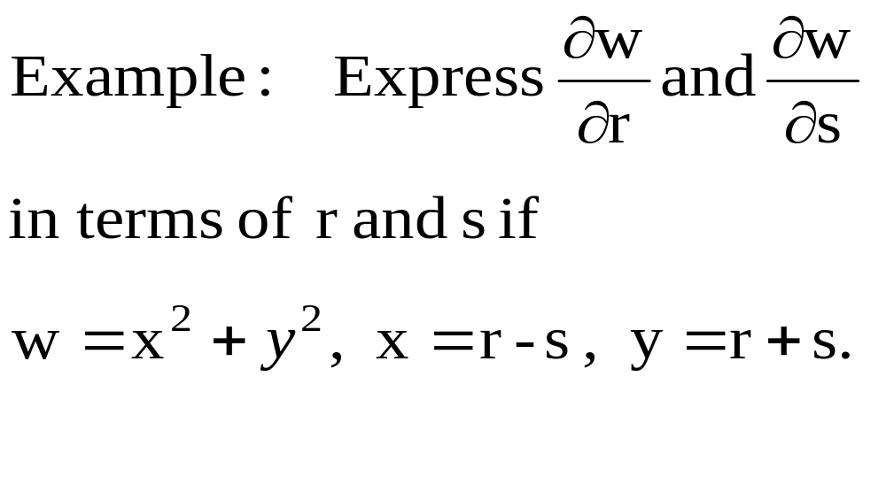

Slide 17
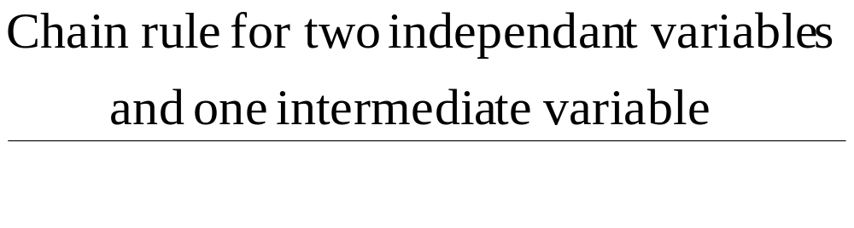
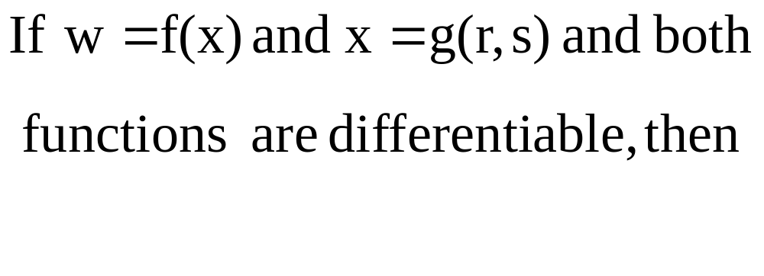
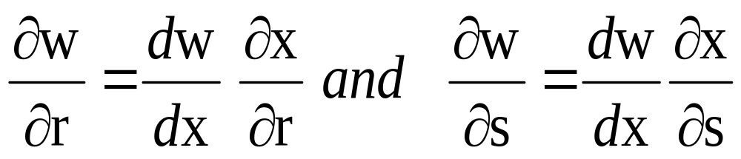

Slide 18
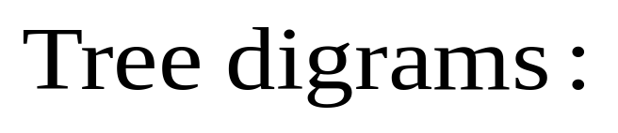
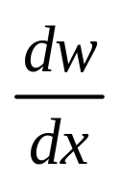
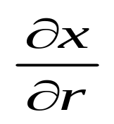
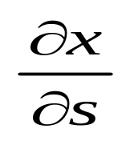
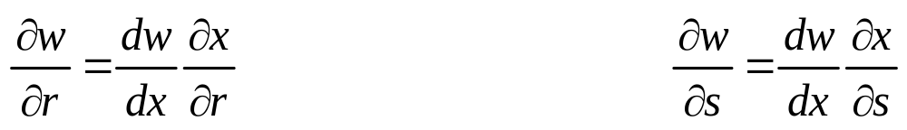
w=f(x)
w
x
x
r
s

Slide 19
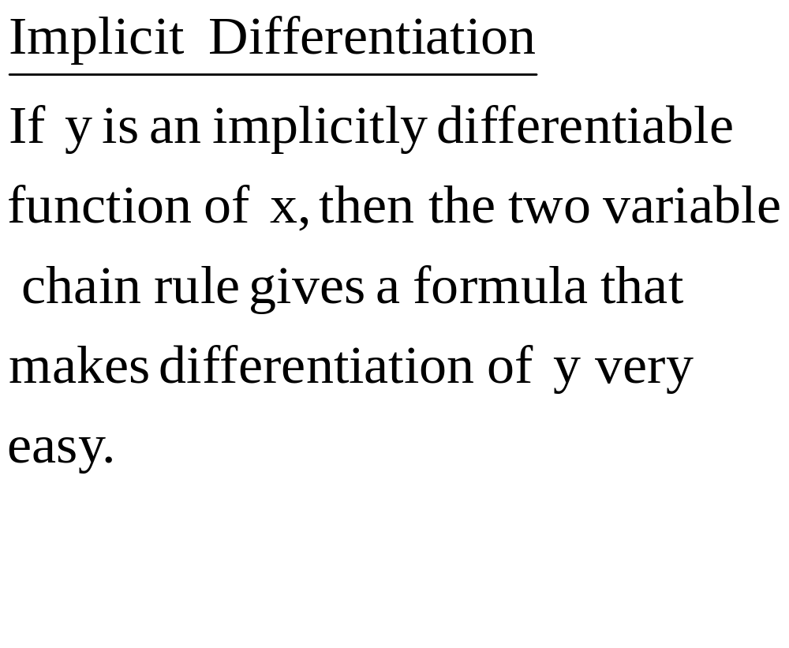

Slide 20
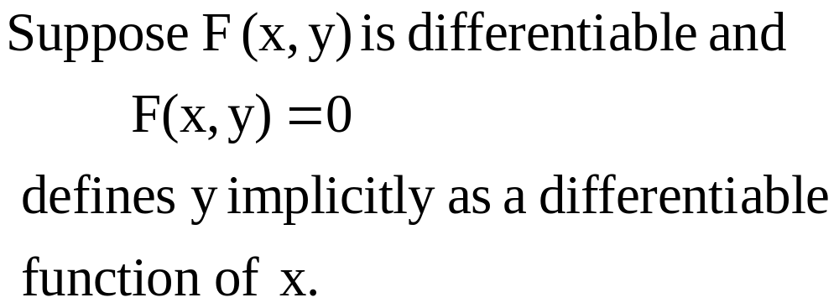
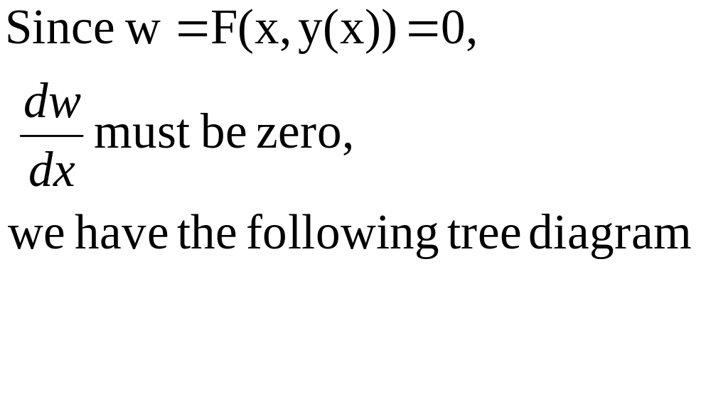

Slide 21

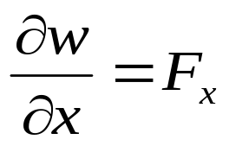
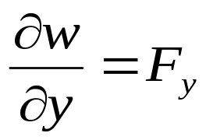
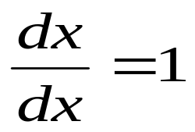
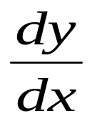
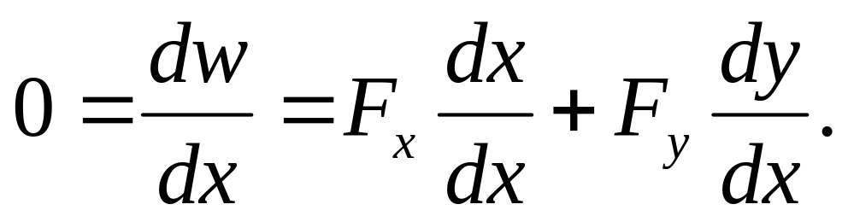
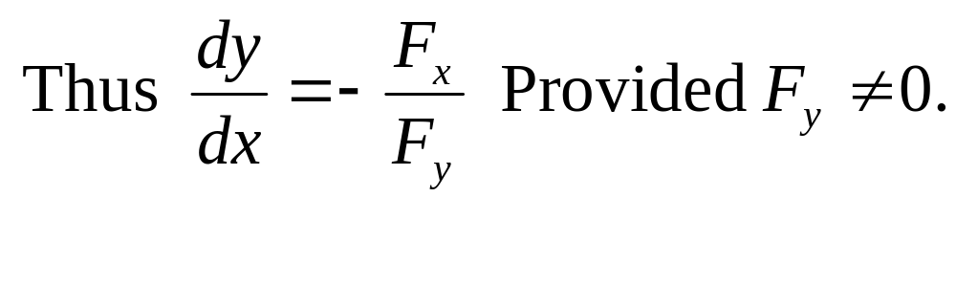
x
y
x

Slide 22
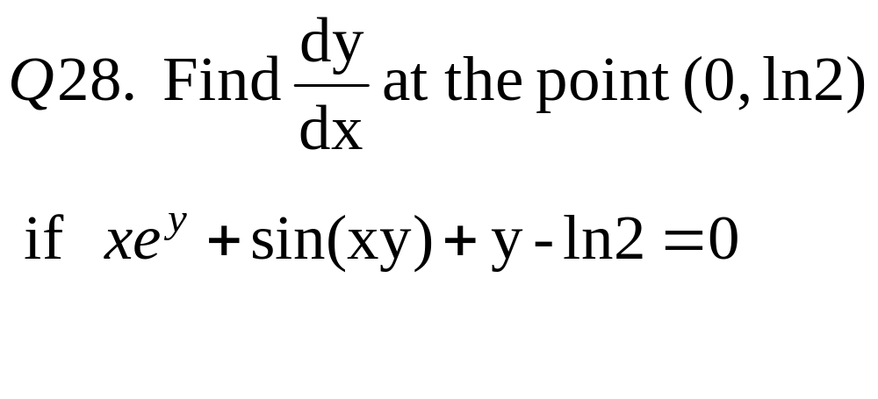
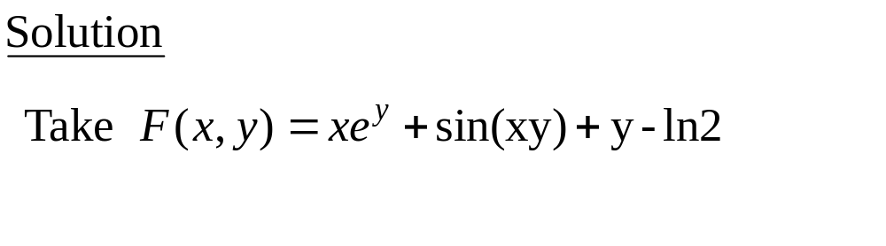
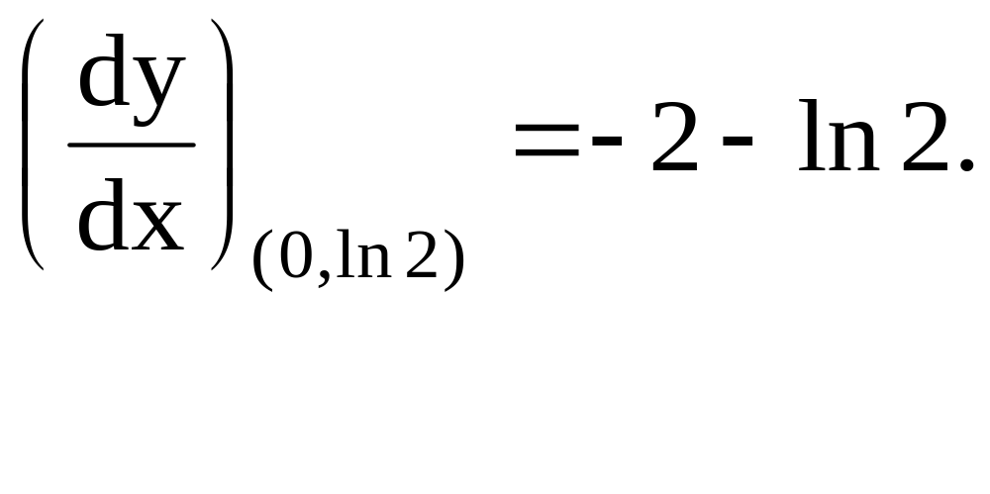

Slide 23
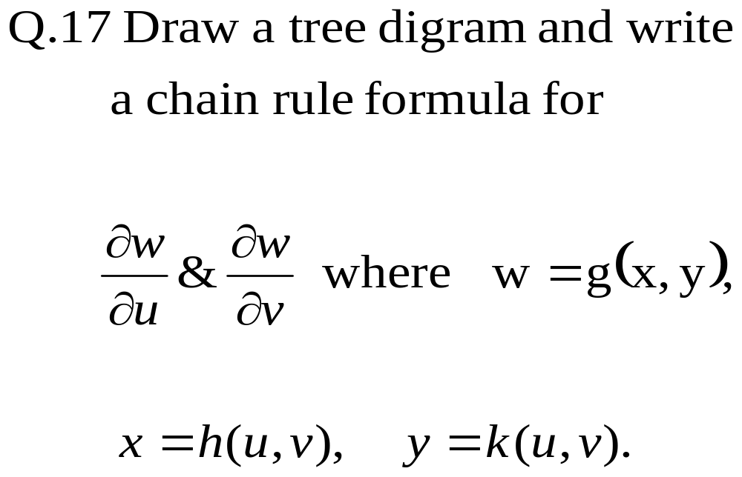

Slide 24
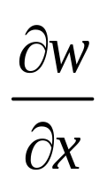
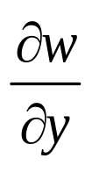
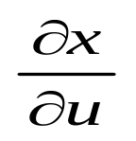
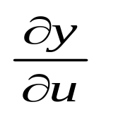
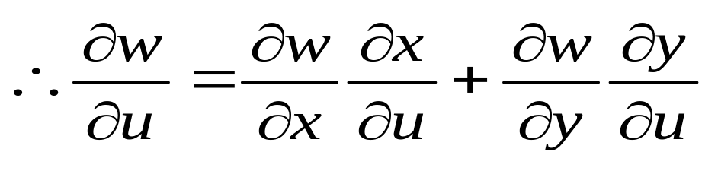
w
y
y
u

Slide 25
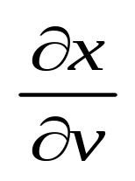
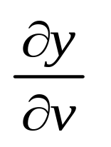
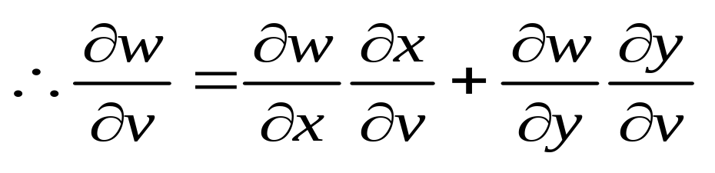
w
y
y
v

Slide 26
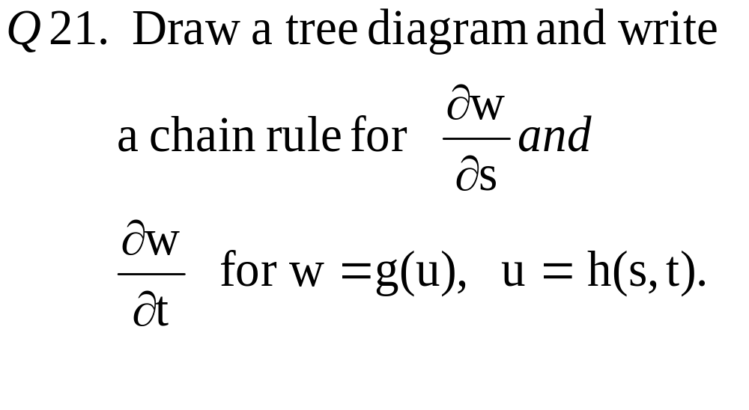

Slide 27
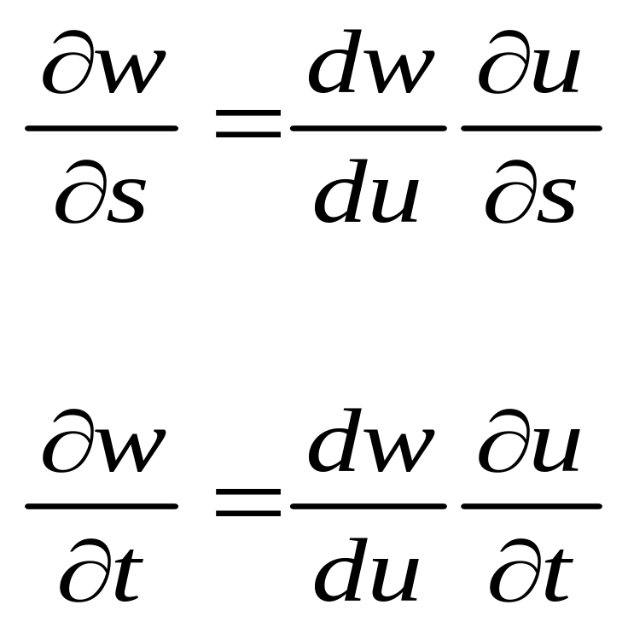
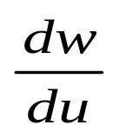


w
u
s
t

Slide 28
Three variable implicit differentiation
Suppose that z is given implicitly as a
function z = f(x, y) by an equation of the
form F(x, y, z) = 0 , i.e.
F(x, y, f(x, y)) = 0 for all (x, y) in the
domain of f. If F and f are
differentiable, then applying chain rule to differentiate the equation F(x, y, z) = 0 as follows:

Slide 29




Slide 30



Slide 31


Slide 32


Slide 33


Soln:

Slide 34




Slide 35



Slide 36



Slide 37


Slide 38


Slide 39



Slide 40


Slide 41
Sec 14.5
DIRECTIONAL DERIVATIVES

Slide 42


Recall:

Slide 43


DIRECTIONAL DERIVATIVES
y
x = x₀ + su₁
y = y₀ + su₂
D
P₀(x₀, y₀)
x
Let f(x, y) be a function defined in a region D in the xy-plane. Let P₀(x₀,y₀) be a point in D, and

Slide 44


Slide 45
f_{x} and f_{y} represent the rate of change of z in the x – and y – directions respectively, i. e., in the directions of the unit vectors i and j.

Slide 46
Geometric Interpretation :
Consider the surface z = f(x, y) (the graph of f)
Let z₀ = f(x₀, y₀)
Then the point P(x₀, y₀, z₀) lies on the surface S

Slide 47


Slide 48
The vertical plane that passes through P in the direction of u intersects S in a curve C.
The slope of the tangent line T to the curve C at the point P is the rate of change of z in the direction of u

Slide 49



Slide 50


Slide 51



Slide 52


Then the rate of change of f at
P₀(x₀, y₀) in the direction of is called directional derivative of f at P₀, and is denoted by

Slide 53




Slide 54




Slide 55




Slide 56


Slide 57

This method works only when f is differentiable.
If not, then this formula can’t be used, but still
D_{u}(f) may exist. Then we have to use definition.
Here f_{x}(0,0) doesn’t exist (Verify)
But D_{u}(f) exists and can be found only by
definition.

Slide 58


Slide 59



Slide 60



Slide 61



Slide 62



Slide 63



Slide 64



Slide 65



y
(2, 1)
x
1
2
-1

Slide 66


Slide 67




Slide 68

Find the directions in which the function f increases and decreases most rapidly at P_{0.} Also find the derivatives of the function f in these directions.

Slide 69


Slide 70



Slide 71



Slide 72



Slide 73


Level curves and gradient
For a point P(x₀,y₀) in the domain of f,
P is on the level curve C : f(x,y)=c
If and only if f(x₀,y₀)=c.
Differentiating w.r.t. t and applying chain rule,

Slide 74

Normal to level curve

Slide 75


Slide 76


Hint : the given information gives you 2 equations in
Solving them, find gradient of f and hence find the final answer.
Alternate way : Express the direction for unknown directional derivative as a linear
Combination of the directions in which directional derivative is known. Then
Required directional derivative is same linear combination of the given directional
derivatives.

Slide 77
14.6 Tangent planes, linearization and differentials

Slide 78
Equation of Tangent plane and Normal line to surface f(x,y,z)= c at the point
(x₀, y₀, z₀) on the surface

Slide 79


Slide 80



Slide 81



Slide 82




Slide 83



Slide 84

Tangent plane

Slide 85


Slide 86



Slide 87


Slide 88



Slide 89


Slide 90



Slide 91


Slide 92
LINEARIZATION TECHNIQUE :
If f(x, y) is differentiable at the point (x₀, y₀). Then
L(x,y)= f(x₀, y₀) + f_{x}(x₀, y₀)(x – x₀)
+ f_{y}(x₀, y₀) ( y – y₀)
is called the standard linear approximation of f at the point
(x₀, y₀) i.e. We have f(x, y) ~ L(x, y)

Slide 93



Slide 94


Slide 95




Slide 96
Linearization L(x,y,z) of f(x,y,z) at a point P(x₀, y₀,z₀)
L(x,y,z)= f(x₀, y₀,z₀ ) +
f_{x}(x₀, y₀,z₀ )(x – x₀)
+ f_{y}(x₀, y₀,z₀ ) ( y – y₀)
+f_{z}(x₀, y₀,z₀ ) ( z – z₀)
L(x,y,z) ~ f(x,y,z)
NOTE: f is diffable at P (assumed)

Slide 97

Linearization and tangent plane

Slide 98


Slide 99



Slide 100


Slide 101

Differentials:
For a function of one variable,
y = f(x), we define the differential dx to be an independent variable.
The differential of y is then defined as

Slide 102


Here the differentials dx, dy are independent.

Slide 103
Relation between the increment Δz and the differential dz:
Δz : change in the height of the
surface z = f(x, y), when
(x, y) changes from (x₀, y₀) to
(x₀+ Δx, y₀+ Δy).

Slide 104
dz : change in the height of the
tangent plane, when
(x, y) changes from (x₀, y₀)
to (x₀+ Δx, y₀+ Δy).
This generalizes to several variables the notion of differential
dy=f′(x)dx for variable y depending on one indep variable x.

Slide 105


Directional derivative
Distance increment

Slide 106


Slide 107


Slide 108



Slide 109


Slide 110
Maxima, minima and saddle points of f(x,y)

Slide 111
Critical points of f(x)
For a function of one variable, points, at which f ′(x) = 0 or does not exist, are critical points
We use f '' to tell us if the point is a:
  max ( f '' < 0 )
  Min ( f '' > 0 )
  Or may be point of inflection ( f '' = 0 )

Slide 112
Critical points
We can use the first order partial derivatives to find critical points on a surface;
We can then use the 2nd order partial derivatives to classify the critical points
critical points can be maxima, minima, or
saddle points

Slide 113
Critical point
Definition: : Let f (x, y) be a function defined in a region R and (x₀, y₀) in an interior point of R. Then (x₀, y₀) is called critical point of f if both f_{x}(x₀, y₀) and f_{y}(x₀, y₀) are zero or one or both of f_{x}(x₀, y₀) & f_{y}(x₀, y₀) do not exist

Slide 114
Definitions :
Let f (x, y) be a function of two variables defined on a region R containing the point (x₀, y₀) then
1. f (x₀, y₀) is a LOCAL MAXIMUM value of f if , f (x₀, y₀) ≥ f (x, y) for all domain points (x, y) in an open disk centered at (x₀, y₀) , point (x₀, y₀) is then called point of maxima.

Slide 115

Typical maximum
Plot of z = 4 - x² - y² showing a maximum at (0,0)

Slide 116
2. f (x₀, y₀) is a LOCAL MINIMUM value of f if f (x₀, y₀) ≤ f (x, y) for all domain points (x, y) in an open disc centered at (x₀, y₀) , the point (x₀,y₀) is then called point of mimima.

Slide 117

Typical minimum
Plot of z = x² + y² showing a minimum at (0,0)

Slide 118
3. If f (x₀, y₀) ≥ f (x, y) for ALL points
(x, y) in the domain of f, then f has an ABSOLUTE MAXIMUM at (x₀, y₀)
4. If f (x₀, y₀) ≤ f (x, y) for ALL points
(x, y) in the domain of f, then f has an ABSOLUTE MINIMUM at (x₀, y₀)

Slide 119
Saddle point:
Let(x₀, y₀) be a critical point of a differentiable function f(x, y).
If in EVERY open disc centered at (x₀, y₀), there are domain points (x, y) where
f(x, y) < f (x₀, y₀)
and domain points (x, y) where
f(x, y) > f (x₀, y₀),
then the point (x₀, y₀, f(x₀, y₀) ) on the surface z = f(x, y) is called saddle point of the surface

Slide 120

Typical saddle point
Plot of z = x² - y² showing a saddle point at (0,0)

Slide 121
Theorem (First derivative test ):
If f(x, y) has a local maximum or minimum at an interior point (x₀, y₀) of its domain and the first order partial derivatives of f exist there, then
f_{x} (x₀, y₀) = 0 and f_{y} (x₀, y₀) = 0.

Slide 122

Proof:
Let g(x) = f(x, y₀)
If f has a local maximum (or minimum) at (x₀, y₀), then g has a local maximum (or minimum) at x = x₀.
  Similarly, using h(y) = f(x₀, y),
  We obtain f_{y}(x₀,y₀) = 0.

Slide 123
Second Derivative Test for Local Extreme Values:
Let f (x, y) and its first & second partial derivatives are continuous throughout a disc centered at (x₀, y₀) and
f_{x} (x₀, y₀) = 0 = f_{y} (x₀, y₀) . Then

Slide 124



Slide 125



Slide 126

Classifying critical points
D | f_{xx} OR f_{yy} | Classification
>0 | >0 | Local Minimum
 | <0 | Local Maximum
<0 |  | Saddle point
=0 |  | Inconclusive
(Hessian or
discriminant)

Slide 127



Example – Classifying stationary points
Find and classify all the stationary points for the function:
Find the first order partial derivatives:

Slide 128



Example – Classifying stationary points
Set these partial derivatives equal to 0:
The first equation will equal 0 if:

Slide 129


Example – Classifying stationary points
Put each value into the second equation and solve:

Slide 130

Example – Classifying stationary points
Put each value into the second equation and solve:

Slide 131

Example – Classifying stationary points
So we find 3 stationary points:
Now we can classify them using the 2nd order partial derivatives.

Slide 132



Example – Classifying stationary points
Find the second order partial derivatives:

Slide 133



Example – stationary points
Now we can set up the table below:
Point |  |  |  | D | Type
(0,0) | 0 | -2 | 0 | 0 | ???
(3,0) | 0 | -2 | 9 | -81 | Saddle
(2,-2) | -12 | -2 | 0 | 24 | Max

Slide 134




Slide 135


Slide 136



Slide 137



Slide 138



Slide 139
Remark:
The extreme values of f(x, y) can occur only at
Boundary points of the domain of f,
Critical points (interior points where f_{x}=f_{y}=0 or points where f_{x} or f_{y} fail to exist)

Slide 140



